Slide 1
EIE 411 COMPUTER ORGANIZATION AND ARCHITECTURE
MODULE 2: COMPUTER ARITHMETIC

Slide 2
MODULE 2
Computer Arithmetic:
1. Integer arithmetic;
(addition, subtraction, multiplication, division),
2. Floating-point representation (IEEE),
3. Floating-point arithmetic.

Slide 3
INTEGER ARITHMETIC
operations we'll get to know (and love):
addition
subtraction
multiplication
division
logical operations (not, and, or, nand, nor, xor, xnor)
shifting
the rules for doing the arithmetic operations vary depending
on what representation is implied.

Slide 4
A LITTLE BIT ON ADDING
An overview.
carry in a b | sum carry out
---------------+----------------
0 0 0 | 0 0
0 0 1 | 1 0
0 1 0 | 1 0
0 1 1 | 0 1
1 0 0 | 1 0
1 0 1 | 0 1
1 1 0 | 0 1
1 1 1 | 1 1

Slide 5
A LITTLE BIT ON ADDING (cont.)
a 0011
b +0001
-- -----
sum 0100
its really just like we do for decimal!
0 + 0 = 0
1 + 0 = 1
1 + 1 = 2 which is 10 in binary, sum is 0 and carry the 1.
1 + 1 + 1 = 3 sum is 1, and carry a 1.

Slide 6
ADDITION
unsigned:
just like the simple addition given.
examples:
100001 00001010 (10)
+011101 +00001110 (14)
-------- ----------------
111110 00011000 (24)

Slide 7
ADDITION (cont.)
Ignore (throw away) carry out of the MSB.
Why?
Because computers ALWAYS work with a fixed precision.

Slide 8
SIGN MAGNITUDE:
rules:
- add magnitudes only (do not carry into the sign bit)
- throw away any carry out of the msb of the magnitude
(Due, again, to the fixed precision constraints.)
- add only integers of like sign ( + to + or - to -)
- sign of result is same as sign of the addends

Slide 9
SIGN MAGNITUDE: (cont.)
examples:
0 0101 (5) 1 1010 (-10)
+ 0 0011 (3) + 1 0011 (-3)
------------- -----------------
0 1000 (8) 1 1101 (-13)

Slide 10
ONE'S COMPLEMENT:
By example
00111 (7) 111110 (-1) 11110 (-1)
+ 00101 (5) + 000010 (2) + 11100 (-3)
----------- ------------ ------------
01100 (12) 1 000000 (0) wrong! 1 11010 (-5) wrong!
+ 1 + 1
---------- ----------
000001 (1) right! 11011 (-4) right!

Slide 11
ONE'S COMPLEMENT: (CONT.)
So it seems that if there is a carry out (of 1) from the msb, then the result will be off by 1, so add 1 again to get the correct result. (Implementation in HW called an "end around carrry.")

Slide 12
TWO'S COMPLEMENT:
Rules:
- just add all the bits
- throw away any carry out of the msb
- (same as for unsigned!)

Slide 13
TWO'S COMPLEMENT: (cont.)
Examples
00011 (3) 101000 111111 (-1)
+ 11100 (-4) + 010000 + 001000 (8)
------------ ---------- ----------------
11111 (-1) 111000 1 000111 (7)

Slide 14
TWO'S COMPLEMENT: (cont.)
After seeing examples for all these representations, you may see
why 2's complement addition requires simpler hardware than sign magnitude or one's complement addition.

Slide 15
SUBTRACTION
General rules:
1 - 1 = 0
0 - 0 = 0
1 - 0 = 1
10 - 1 = 1
0 - 1 = borrow!

Slide 16
SUBTRACTION (cont.)
unsigned:
- it only makes sense to subtract a smaller number from a larger one
examples
1011 (11) must borrow
- 0111 (7)
------------
0100 (4)

Slide 17
SUBTRACTION (cont.)
sign magnitude:
- if the signs are the same, then do subtraction
- if signs are different, then change the problem to addition
- compare magnitudes, then subtract smaller from larger
- if the order is switched, then switch the sign too.

Slide 18
SUBTRACTION (cont.)
- when the integers are of the opposite sign, then do
a - b becomes a + (-b)
a + b becomes a - (-b)

Slide 19
SUBTRACTION (cont.)
examples
0 00111 (7) 1 11000 (-24)
- 0 11000 (24) - 1 00010 (-2)
------------------ --------------
1 10110 (-22)
do 0 11000 (24)
- 0 00111 (7)
--------------
1 10001 (-17)
(switch sign since the order of the subtraction was reversed)

Slide 20
SUBTRACTION (cont.)
one's complement:
figure it out on your own

Slide 21
SUBTRACTION (cont.)
two's complement:
- change the problem to addition!
a - b becomes a + (-b)
- so, get the additive inverse of b, and do addition.

Slide 22
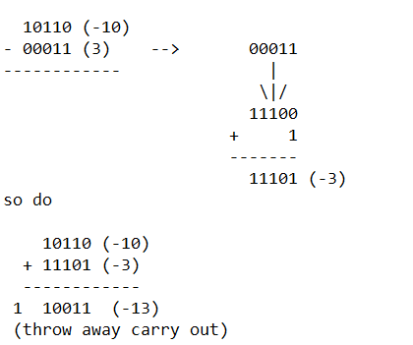
SUBTRACTION (cont.) Example

Slide 23
OVERFLOW DETECTION IN ADDITION
unsigned -- when there is a carry out of the msb
1000 (8)
+1001 (9)
--------------
1 0001 (1)
sign magnitude -- when there is a carry out of the msb of the magnitude

Slide 24
OVERFLOW DETECTION IN ADDITION (cont.)
1 1000 (-8)
+ 1 1001 (-9)
---------------
1 0001 (-1) (carry out of msb of magnitude)
2's complement -- when the signs of the addends are the same, and the sign of the result is different.

Slide 25
OVERFLOW DETECTION IN ADDITION (cont.)
0011 (3)
+ 0110 (6)
-----------
1001 (-7)
(note that a correct answer would be 9, but 9 cannot be represented in 4 bit 2's complement)
A detail -- you will never get overflow when adding 2 numbers of opposite signs

Slide 26
OVERFLOW DETECTION IN SUBTRACTION
unsigned –- never
sign magnitude -- never happen when doing subtraction
2's complement -- we never do subtraction, so use the addition rule on the addition operation done.

Slide 27
MULTIPLICATION OF INTEGERS
0 x 0 = 0
0 x 1 = 0
1 x 0 = 0
1 x 1 = 1

Slide 28
MULTIPLICATION OF INTEGERS
-----Longhand, it looks just like decimal
---- The result can require 2x as many bits as the larger multiplicand
--- In 2's complement, to always get the right answer without thinking about the problem, sign extend both multiplicands to2x as many bits (as the larger). Then take the correct number of result bits from the least significant portion of the result.

Slide 29
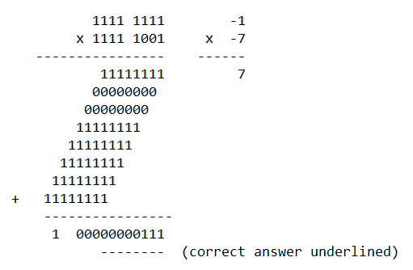
MULTIPLICATION OF INTEGERS
2's complement example:

Slide 30
DIVISION OF INTEGERS
Unsigned only!
example of
15 / 3 1111 / 011
To do this longhand, use the same algorithm as for decimal integers.

Slide 31
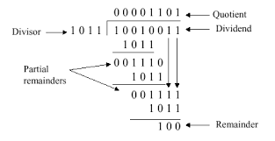
DIVISION OF INTEGERS
Division
At every step, shift divisor right and compare it with current dividend
if divisor is larger, shift 0 as the next bit of the quotient
if divisor is smaller, subtract to get new dividend and shift 1 as the next bit of the quotient

Slide 32
FIXED POINT NUMBERS
A fixed point number has a specific number of bits (or digits) reserved for the integer part (the part to the left of the radix point) and a specific number of bits reserved for the fractional part (the part to the right of the radix point). No matter how large or small your number is, it will always use the same number of bits for each portion. Every bit of code that processes such numbers has to have built-in knowledge of where the radix point is.

Slide 33
FLOATING POINT NUMBERS
With floating-point representation, the placement of the radix point can ‘float’ relative to the significant digits of the number.

Slide 34
FIXED POINT ADDITION & SUBTRACTION
Unsigned binary representation
Representing signed binary numbers
Sign-magnitude representation
1’s complement representation
2’s complement representation
Solves the problem of multiple representation for zero, end-around carry
Fixed point addition and subtraction

Slide 35
DECODING 1'S COMPLEMENT NUMBERS
Check the sign bit (denoted as S).
If S=0, the number is positive and its absolute value is the binary value of the remaining n-1 bits.
If S=1, the number is negative and its absolute value is the binary value derived by inverting the remaining n-1 bits..

Slide 36
DECODING 2'S COMPLEMENT NUMBERS
Check the sign bit (denoted as S).
If S=0, the number is positive and its absolute value is the binary value of the remaining n-1 bits.
If S=1, the number is negative. You can get the absolute value using any of these 3 methods:
Method 1: Subtract 1 from the remaining n-1 bits then invert.
Method 2: Invert the remaining n-1 bits then add 1.
Scan the remaining n-1 bits from the right (LSB) for the first occurrence of 1. Invert all the bits to the left of that first occurrence of 1. The flipped pattern gives the absolute value. For example, n = 8, bit pattern = 1 100 0100B S = 1 → negative. Scanning from the right and flippping all the bits to the left of the first occurrence of 1 ⇒ 011 1100B = 60D Hence, the value is -60D

Slide 37
OVERFLOWS
When two numbers of n bits each are added and the sum occupies n+1 bits, we say that an overflow occurred. An overflow is a problem in digital computers because the width of registers is finite.
n+1 bits result cannot be accommodated in n bits register.
For an unsigned number, overflow happens when the last carry (1) cannot be accommodated
For a signed number, overflow happens
when the carry into the sign bit position is not the same as the carry out of the sign bit position
when the sum of two positive numbers is a negative result
when the sum of two negative numbers is a positive result
The sum of a positive and negative number will never overflow

Slide 38
Summary
Integer arithmetic;
Addition, Subtraction, Multiplication, Division,
Sign-magnitude representation
1’s complement representation
2’s complement representation

Slide 39
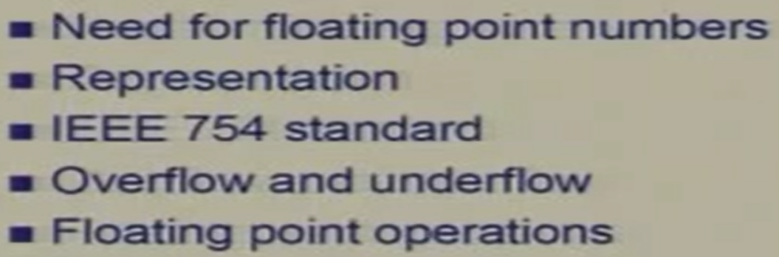
OUTLINE

Slide 40
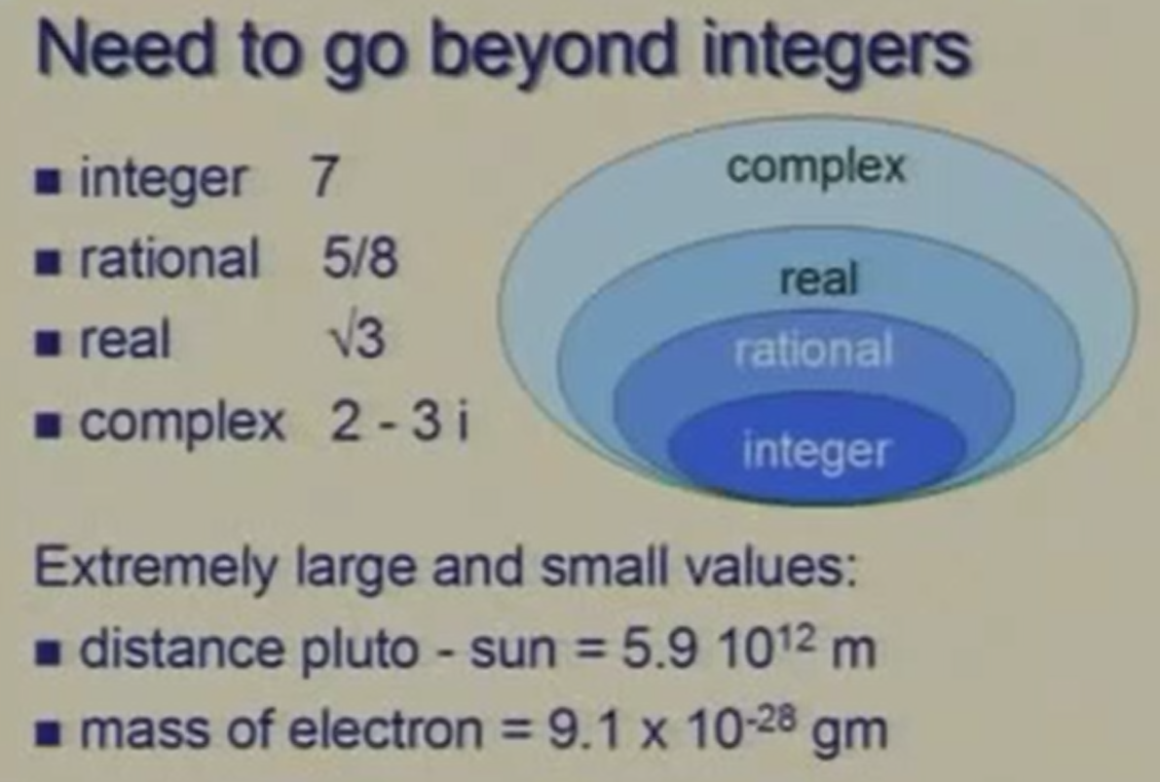

Slide 41
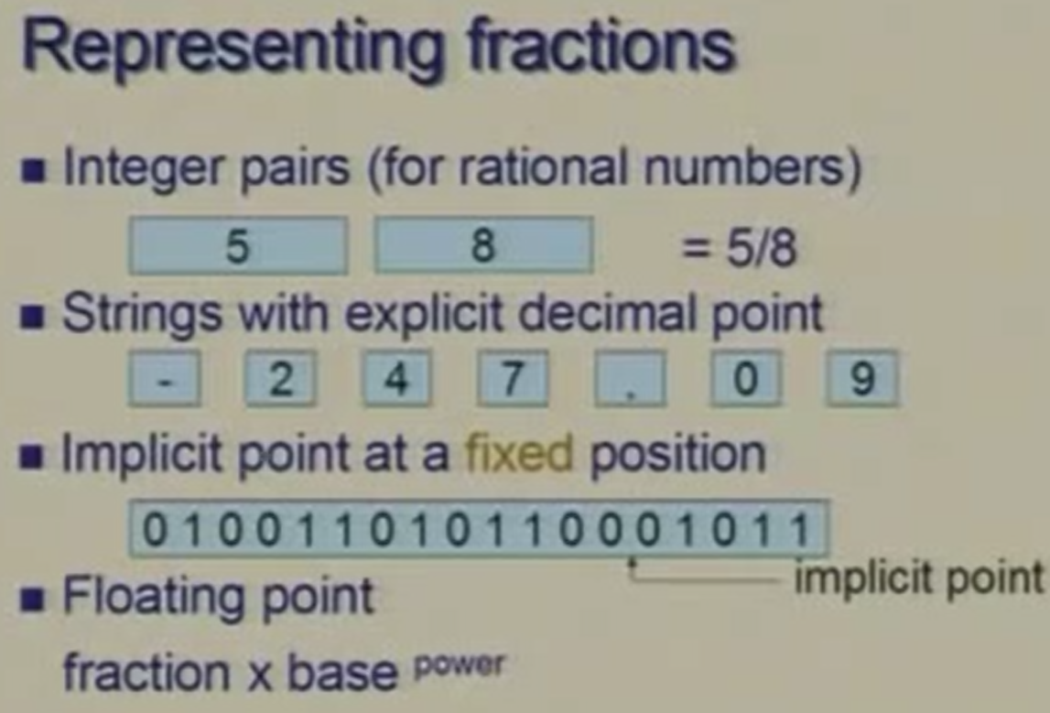

Slide 42
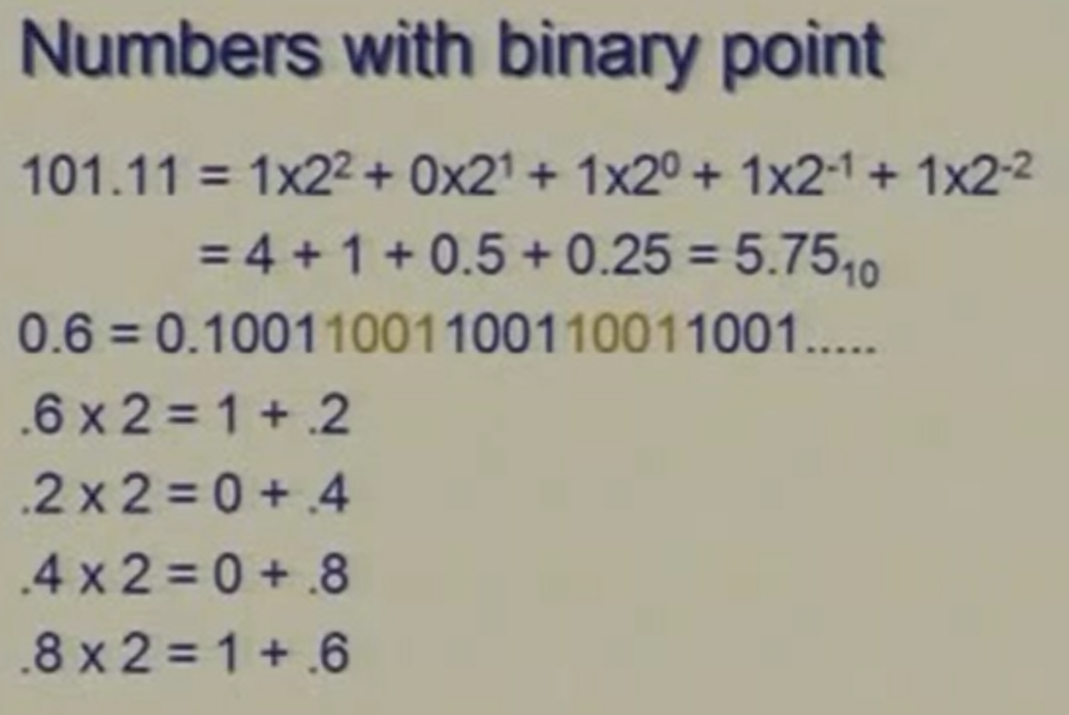

Slide 43
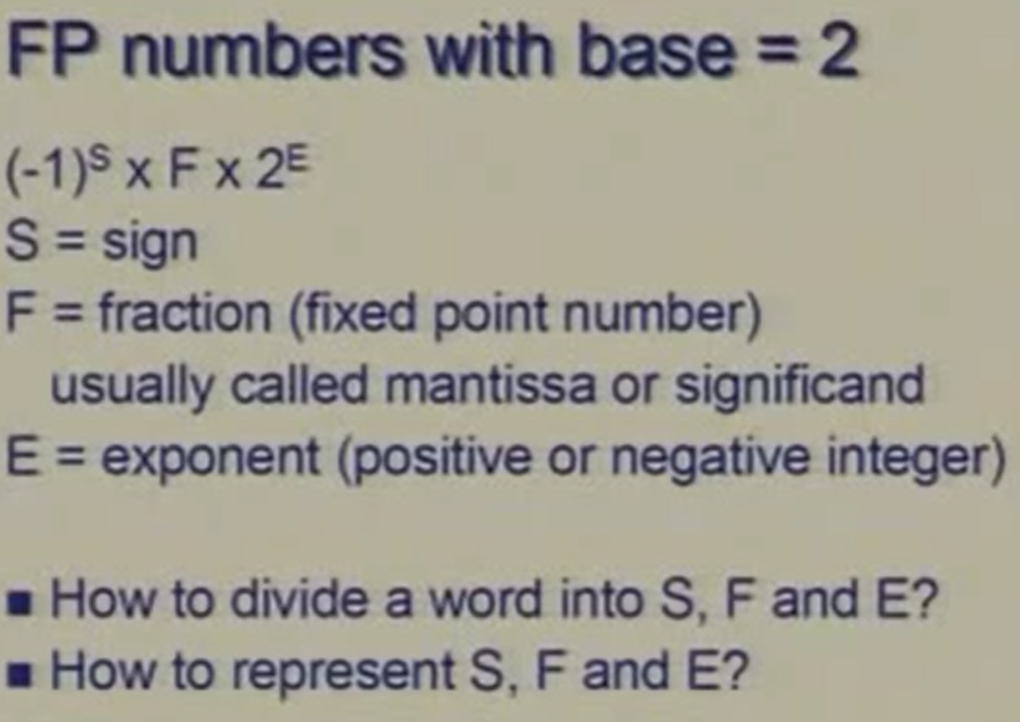

Slide 44
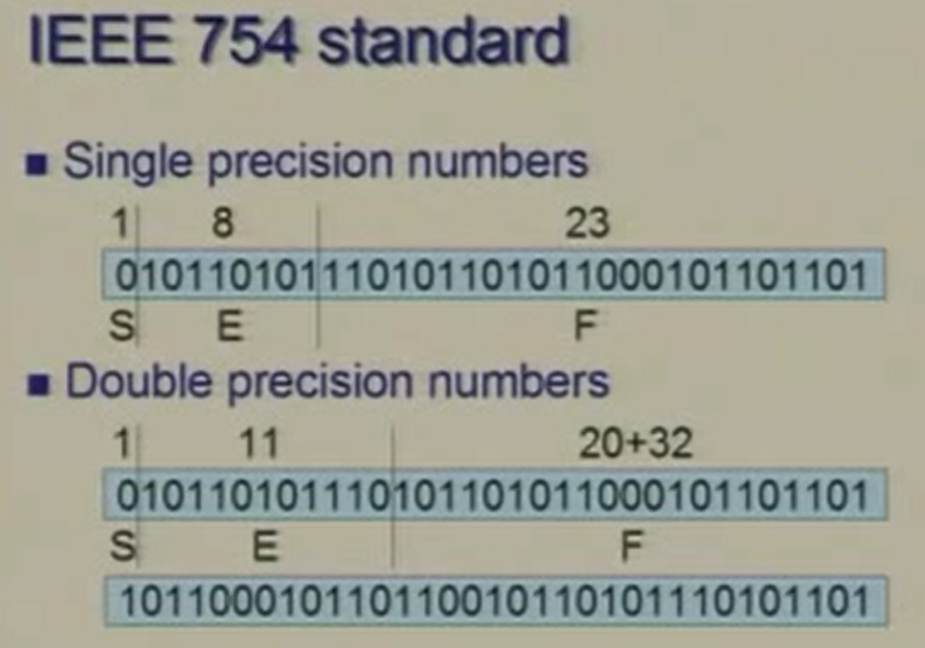

Slide 45
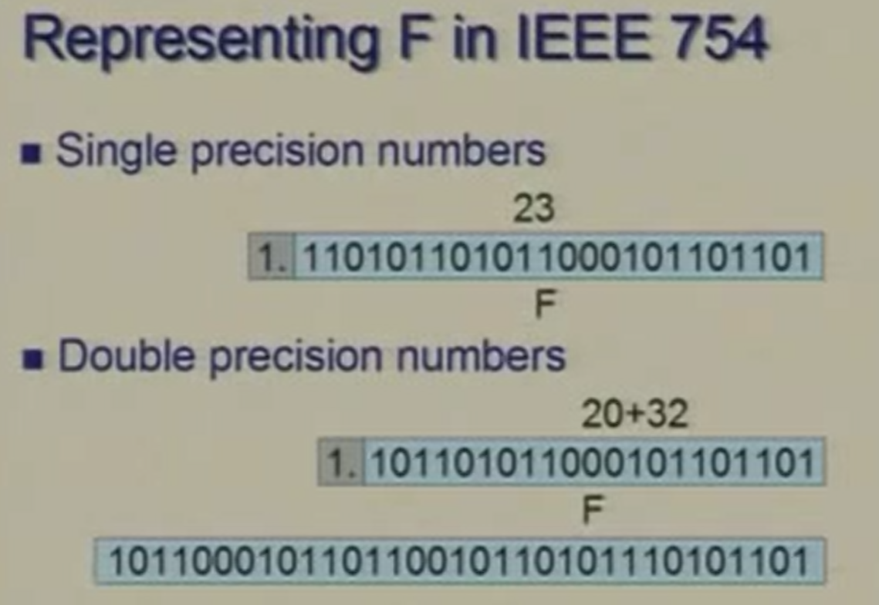

Slide 46
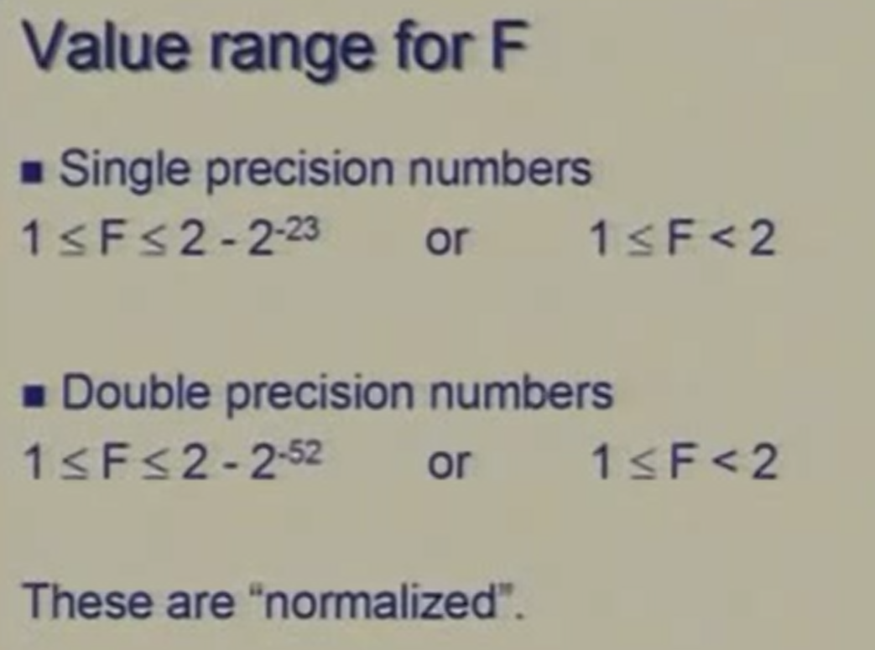

Slide 47
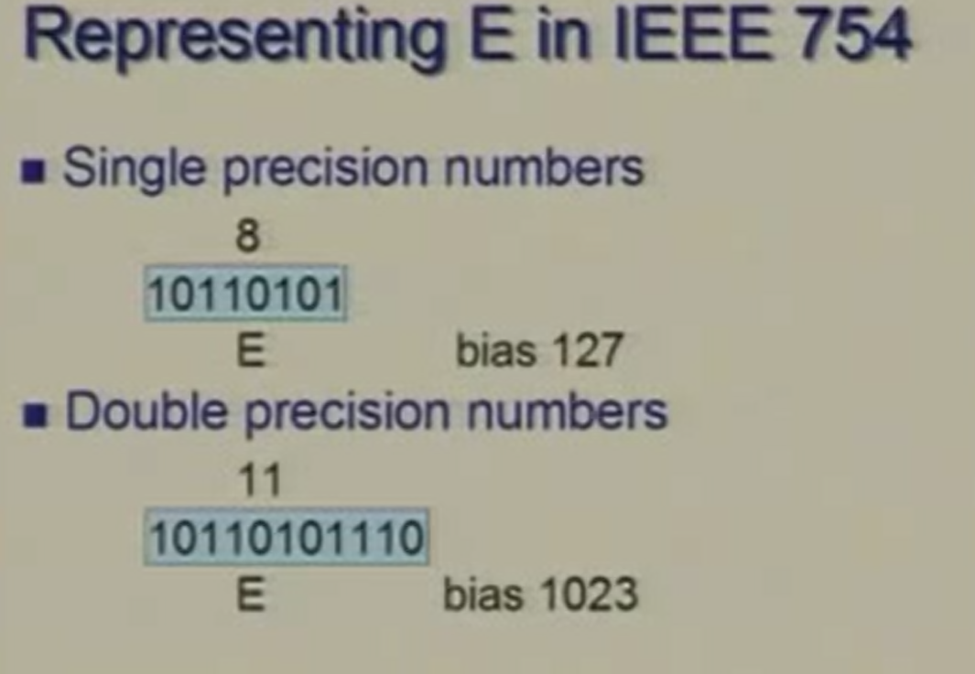

Slide 48
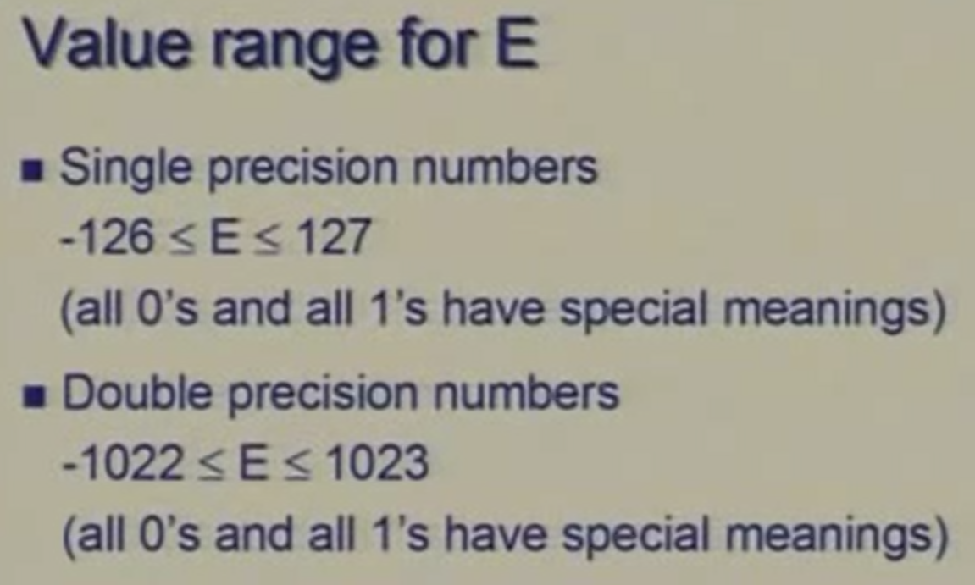

Slide 49
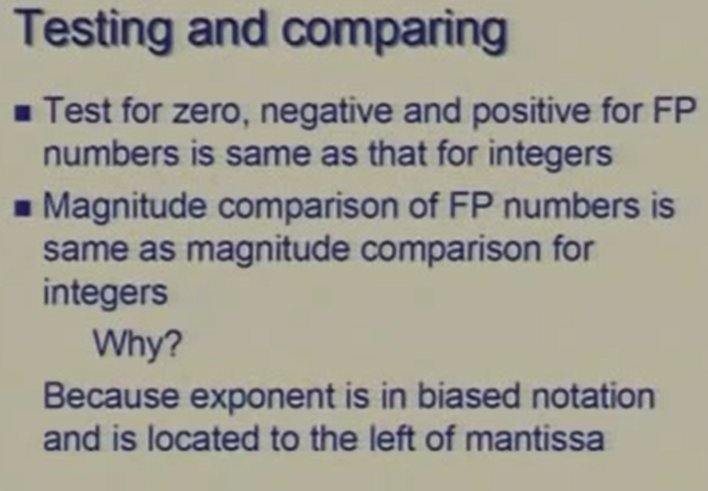

Slide 50
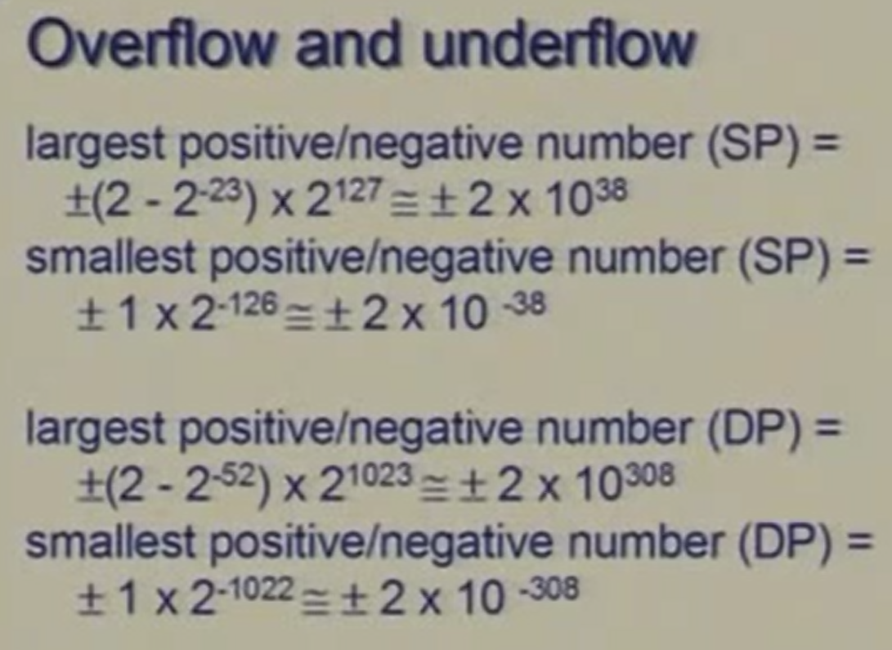

Slide 51
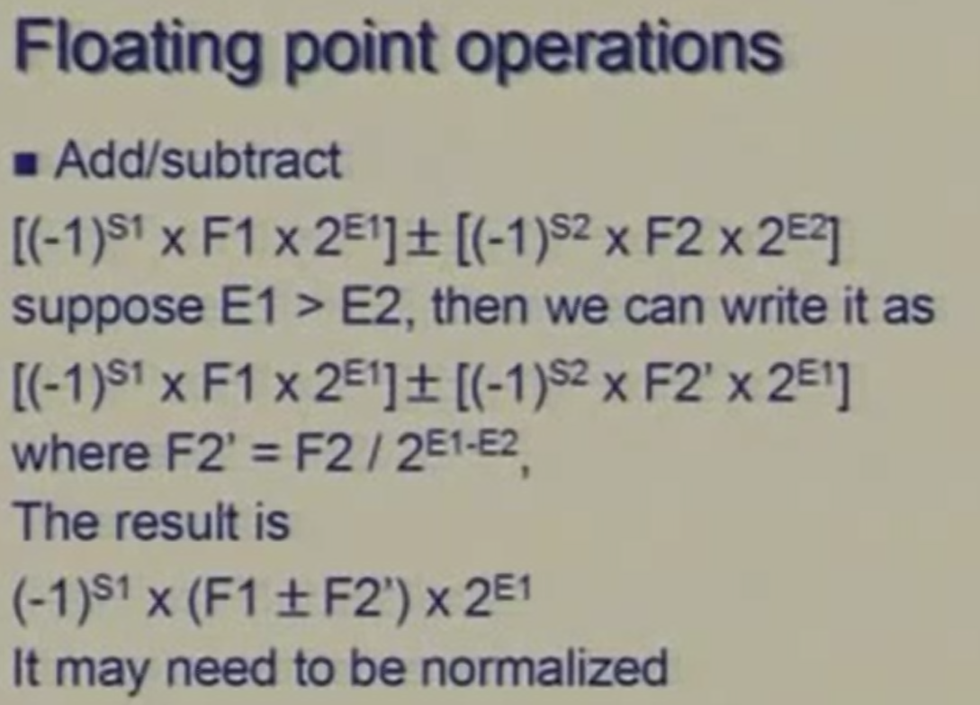

Slide 52
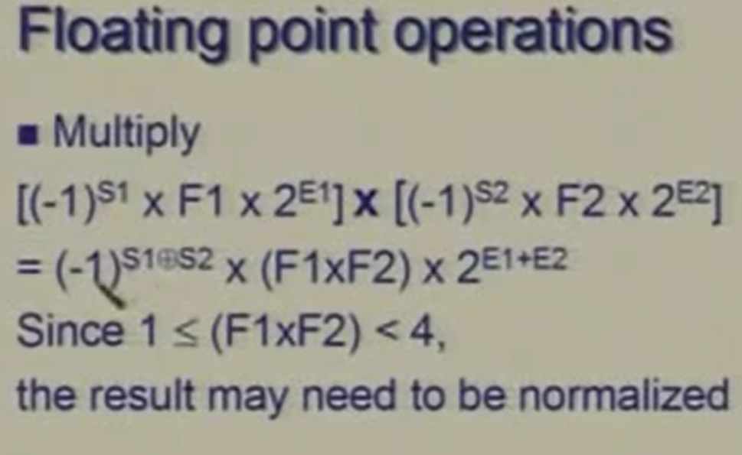

Slide 53
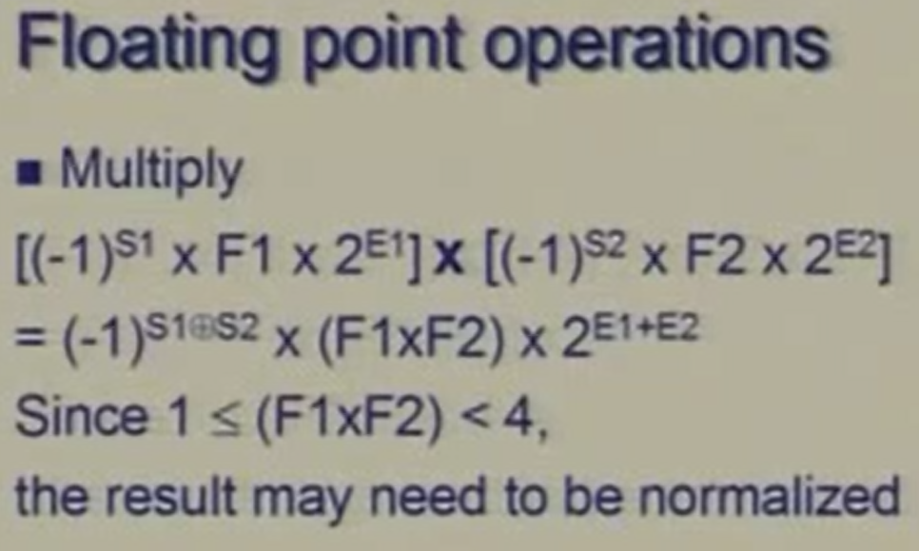

Slide 54
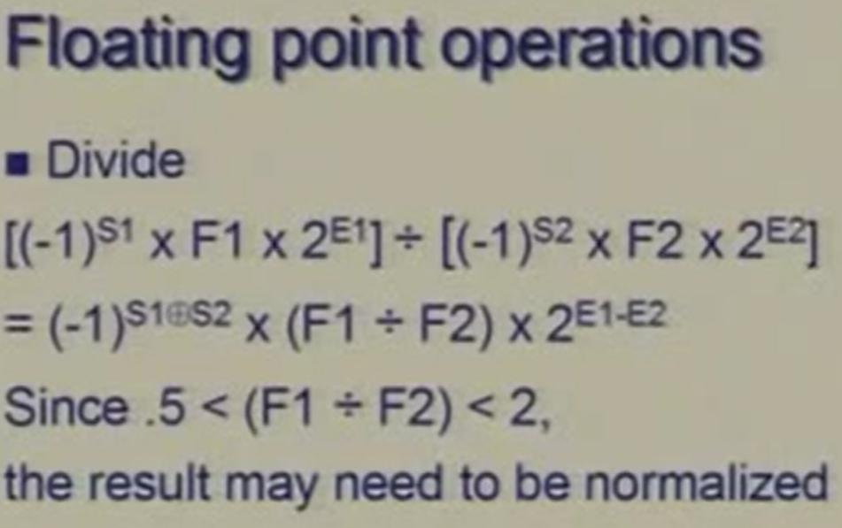

Slide 55
Assignment: Submission Date: Monday 5/09/16, latest 3pm.
Derive the correct Floating-point representation for the decimal number +3.25 and -3.25 using the 32-bit IEEE 754 Floating-point standard.
Convert the following IEEE 754 single precision Floating point numbers to their decimal values.
00111111111100000000000000000000
01100110100110000000000000000000
(3) Convert the following Flowing-point Number sign bit to 2’s complement representation.
(a) +7.25 (b) -7.25

Slide 56
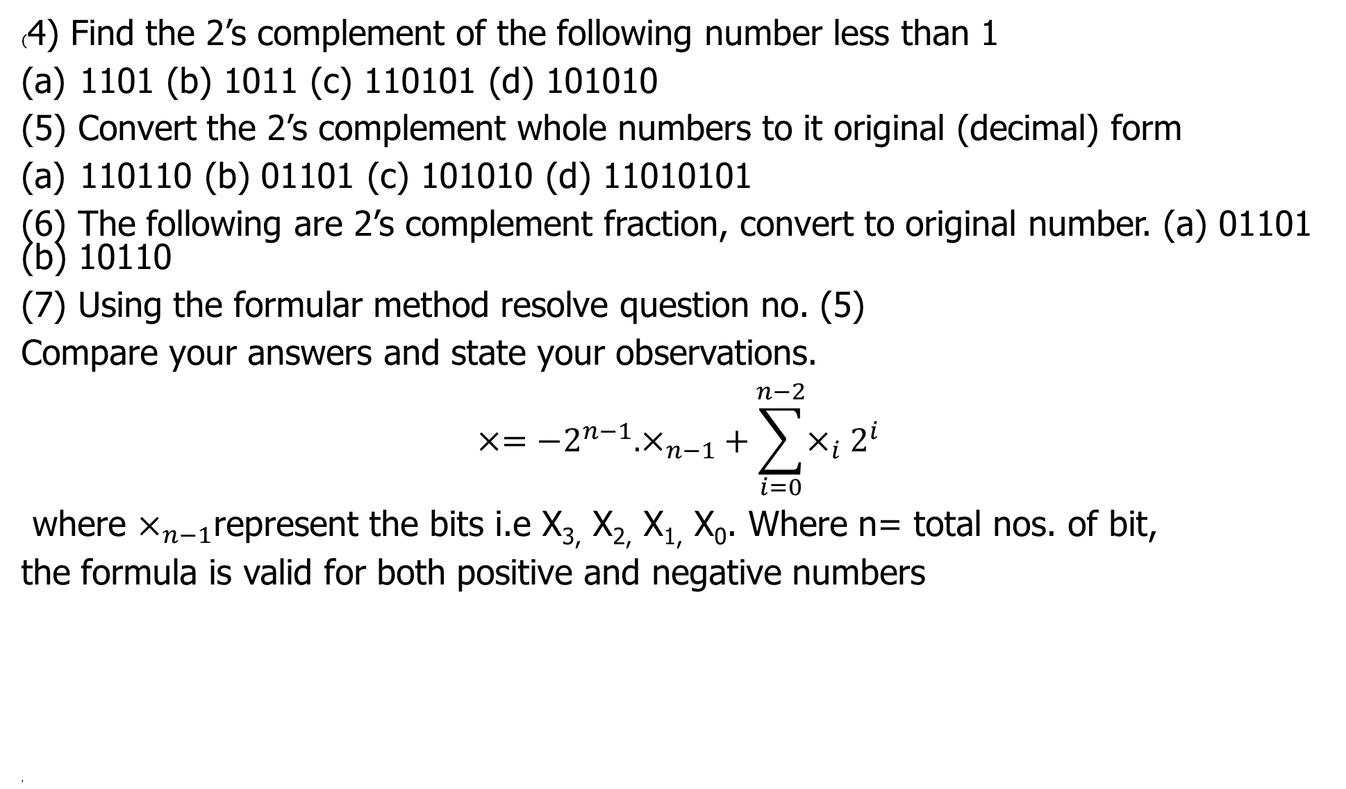
Assignment: Submission Date: Monday 5/09/16, latest 3pm.(contd)
(4) Find the 2’s complement of the following number less than 1
1101 (b) 1011 (c) 110101 (d) 101010
(5) Convert the 2’s complement whole numbers to it original (decimal) form
110110 (b) 01101 (c) 101010 (d) 11010101
(6) The following are 2’s complement fraction, convert to original number. (a) 01101 (b) 10110
(7) Using the formular method resolve question no. (5)
Compare your answers and state your observations.
$$×={−2}^{n−1}.×_{n−1}+\sum_{i=0}^{n−2}{×_{i}2^{i}}$$
where $×_{n−1}$represent the bits i.e X_{3,} X_{2,} X_{1,} X₀. Where n= total nos. of bit,
the formula is valid for both positive and negative numbers
,

Slide 57
Reference
Okokpujie, K. Lecture notes, EIE411, 2016.

